Slide 1
Climate Change: Industry vs. the Citizen
David G. Kinney
Bellevue University
DSC 680 – Spring 2021
Professor Catherine Williams

Slide 2
Confessions of a cranky old man…
The effects of climate change are increasingly visible. Storms, droughts, fires, and flooding have become stronger and more frequent
It is my subjective observation that a groundswell of concern and effort at the grass roots level is taking hold
It is my hypothesis that individual effort likely pales in comparison to what is required of major industries notorious for large volumes of greenhouse gas emissions, the major cause of adverse climate change.

Slide 3
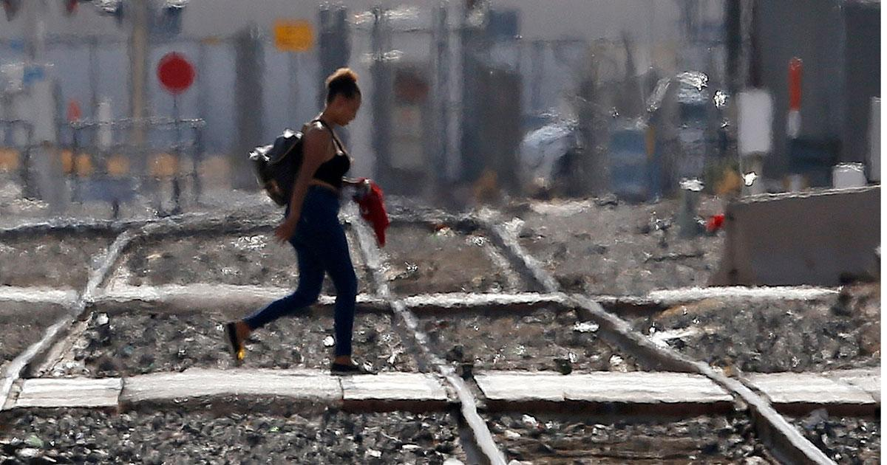
Hotter…
When carbon dioxide (CO2) is released into the atmosphere, it acts like a blanket, preventing heat from escaping. This buildup of CO2 leads to one of most obvious impacts of climate change: a hotter world.
Higher temperatures are linked to almost all of climate change’s most severe impacts, including more frequent and intense heat waves, widespread crop failures, and dramatic shifts in animal and plant ranges.
The world’s most vulnerable people—those with fewest resources and options—will suffer the most.
Source: https://www.ucsusa.org/resources/heat-waves-and-climate-change
A woman crosses the railroad tracks as temperatures climb past 112-degrees in Phoenix, July 5, 2018.
AP Photo/Ross D. Franklin

Slide 4
Industry vs. Residents
Transportation (29 percent of 2019 greenhouse gas emissions) – The transportation sector generates the largest share of greenhouse gas emissions. Greenhouse gas emissions from transportation primarily come from burning fossil fuel for our cars, trucks, ships, trains, and planes. Over 90 percent of the fuel used for transportation is petroleum based, which includes primarily gasoline and diesel.2
Electricity production (25 percent of 2019 greenhouse gas emissions) – Electricity production generates the second largest share of greenhouse gas emissions. Approximately 62 percent of our electricity comes from burning fossil fuels, mostly coal and natural gas.3
Industry (23 percent of 2019 greenhouse gas emissions) – Greenhouse gas emissions from industry primarily come from burning fossil fuels for energy, as well as greenhouse gas emissions from certain chemical reactions necessary to produce goods from raw materials.
Commercial and Residential (13 percent of 2019 greenhouse gas emissions) – Greenhouse gas emissions from businesses and homes arise primarily from fossil fuels burned for heat, the use of certain products that contain greenhouse gases, and the handling of waste.
Agriculture (10 percent of 2019 greenhouse gas emissions) – Greenhouse gas emissions from agriculture come from livestock such as cows, agricultural soils, and rice production.
Land Use and Forestry (12 percent of 2019 greenhouse gas emissions) – Land areas can act as a sink (absorbing CO2 from the atmosphere) or a source of greenhouse gas emissions. In the United States, since 1990, managed forests and other lands are a net sink, i.e., they have absorbed more CO2 from the atmosphere than they emit.
Source: https://www.epa.gov/ghgemissions/sources-greenhouse-gas-emissions
Million metric tons of CO2 or equivalent

Slide 5
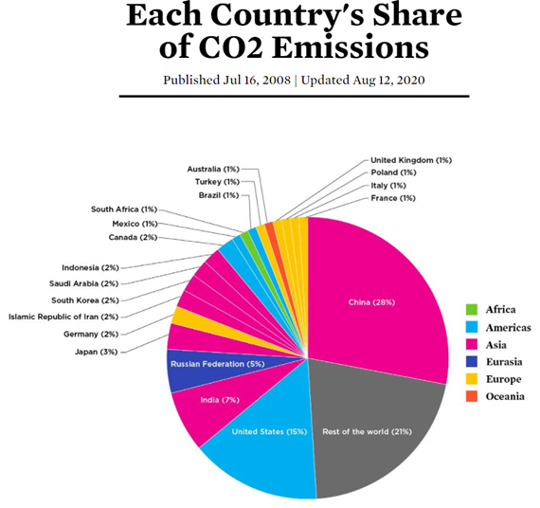
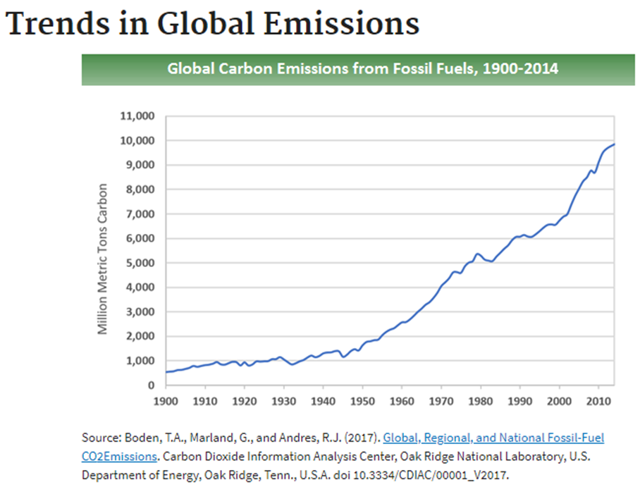
Global Greenhouse Gas Emissions

Slide 6
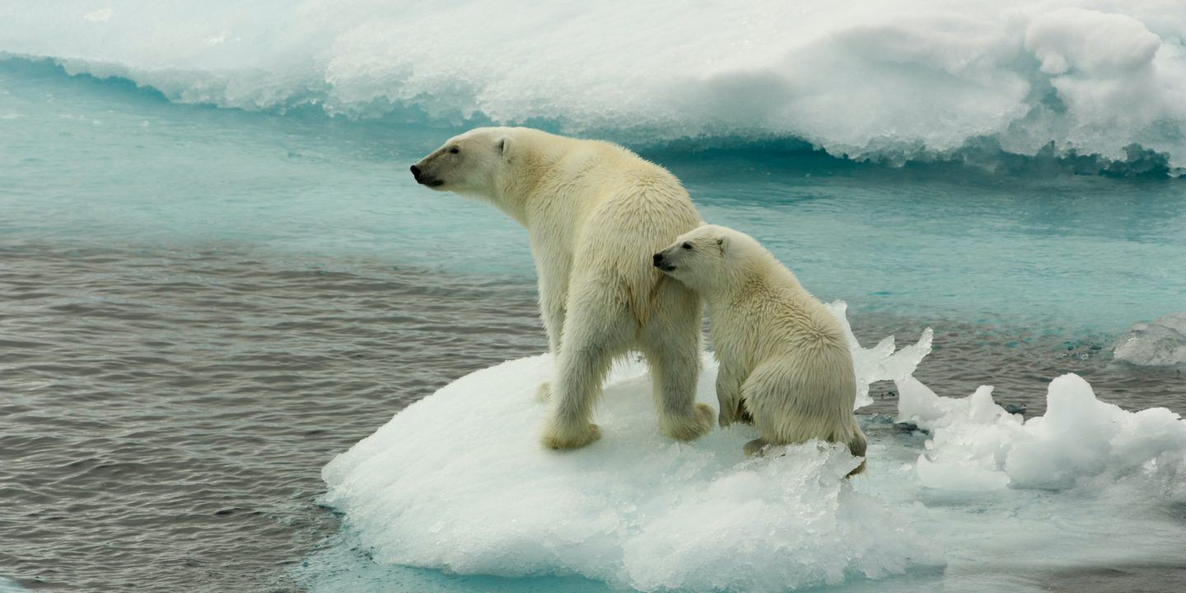
I’m just one human, against multiple Goliaths of industry. Why try?
But we shouldn’t. Because 2°C is better than 3°C and 3°C is better than 4°C.
Often when I think about climate change and what we might do to mitigate it I become forlorn with the hopelessness of it all. It seems so important and yet so insoluble.
Emitting large amounts of CO2 gives us an incredible lifestyle. When we emit there is no immediate feedback mechanism — no way for us to directly feel the cost of our emissions. What’s more, the cost is mostly born by other people. The big, immediate benefits and the lack of direct negative feedback make it hard to persuade ourselves, or our governments, to curb emissions. So hard in fact that I think it is tempting to give it up as a bad job and to get on with our lives. We feel like there is no chance our governments and industries will make the changes needed to meet the Paris Agreement’s aim of limiting global warming to ‘well below 2°C above pre-industrial levels’ — and so we give up.
Source: Stephanie Willis – Concerning Climate – Towards Data Science

Slide 7
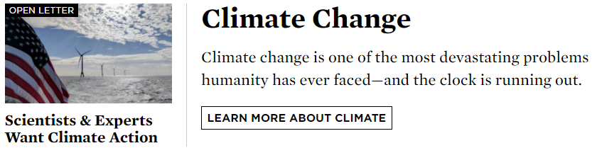
Because I’m not an average citizen. I’m a Data Scientist…
Tackling Climate Change with Machine Learning
Fighting the Climate Crisis: 6 Future Game-Changers Made Possible by Deep Learning

Slide 8

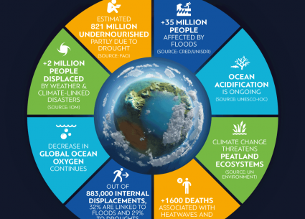


Slide 9
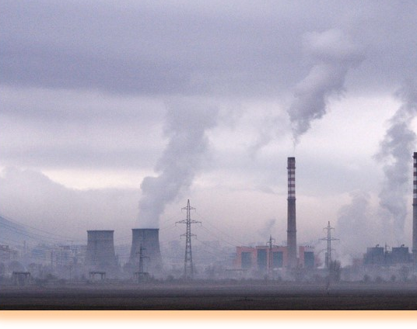
Last words (and not mine…)
“Is it political if I tell you that if we burn coal, you’re going to warm the atmosphere? Or is that a statement of fact that you’ve made political? It’s a scientific statement. The fact that there are elements of society that have made it political, that’s a whole other thing.”
Neil Degrasse Tyson

